Slide 1
Traffic Mortality Analysis
Mini Project 3 by Abhinav Pandey

Slide 2
Outline
Problem
About the Dataset
Principal Component Analysis (PCA)
Unsupervised Learning (Clustering)
Conclusions
Suggestions

Slide 3
Problem Statement
Given the statistics of accidents in different states of the USA, can we find states which are similar to each other in terms of road accidents?
Benefit – Similar strategies can be used on states belonging to the same cluster and reduce traffic mortality efficiently.

Slide 4
About the Dataset
Source - National Highway Traffic Safety Administration and the National Association of Insurance Commissioners (USA)
Features –
State (51 rows)
Number of drivers involved in fatal collisions per billion miles
Percentage Of Drivers Involved In Fatal Collisions Who Were Speeding
Percentage Of Drivers Involved In Fatal Collisions Who Were Alcohol-Impaired
Percentage Of Drivers Involved In Fatal Collisions Who Had Not Been Involved In Any Previous Accidents

Slide 5
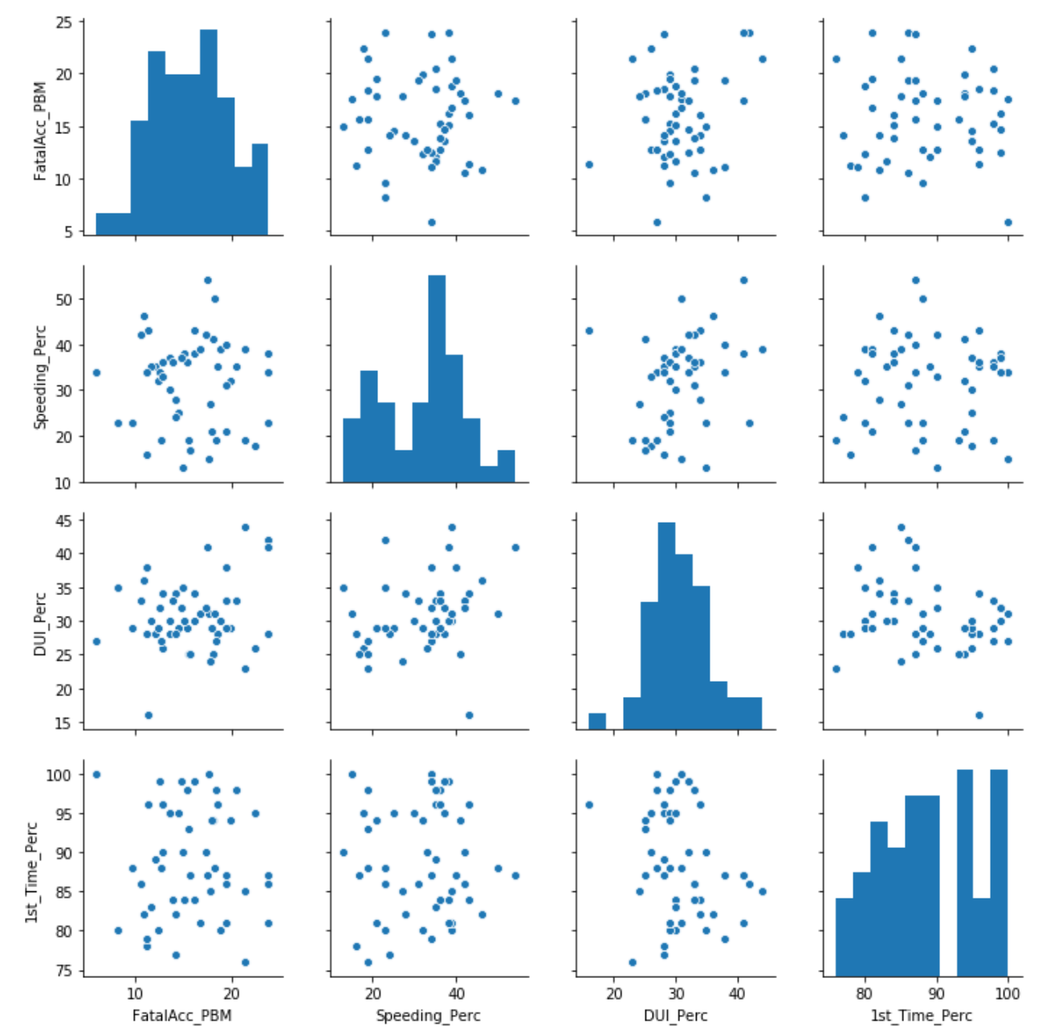
Distributions and Relationships
Number of drivers involved in fatal collisions per billion miles
Percentage Of Drivers Involved In Fatal Collisions Who Were Speeding
Percentage Of Drivers Involved In Fatal Collisions Who Were Alcohol-Impaired
Percentage Of Drivers Involved In Fatal Collisions Who Had Not Been Involved In Any Previous Accidents

Slide 6
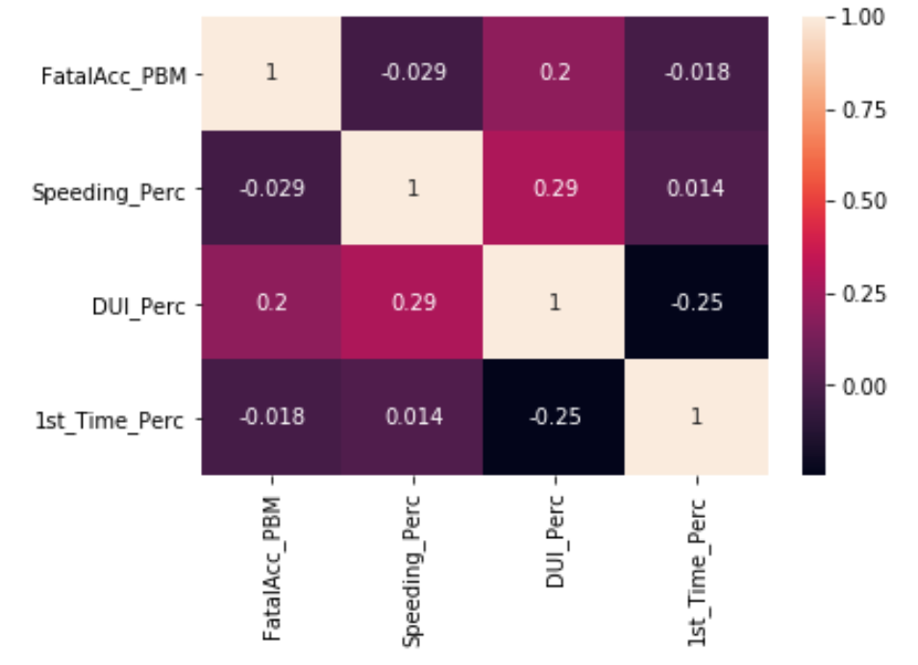
Correlation Matrix

Slide 7
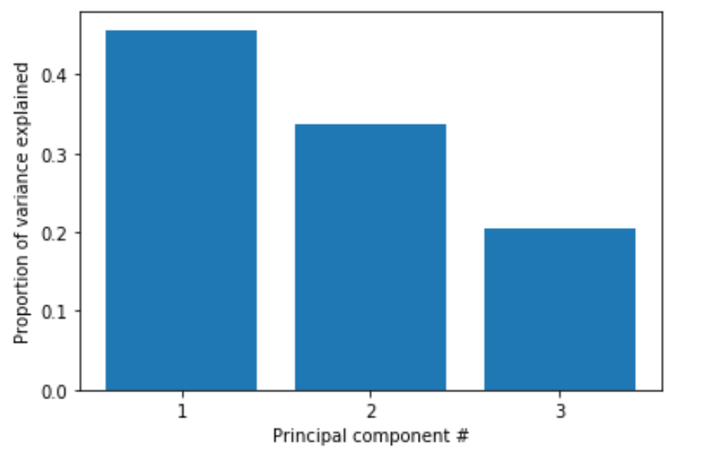
Principal Component Analysis
80%
46.57%
33.80%
19.63%

Slide 8
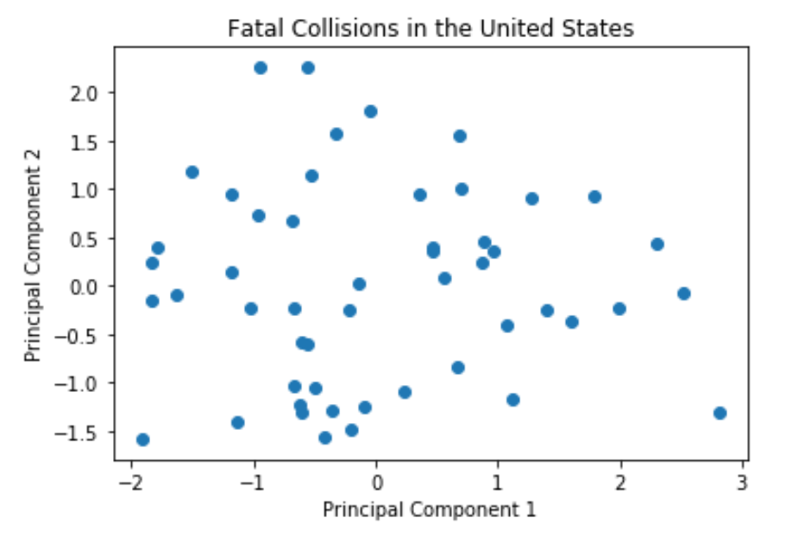
Results of PCA Visualizing states in 2D using Principal Components. This will enable us to form clusters of states and visualize those clusters easily.

Slide 9
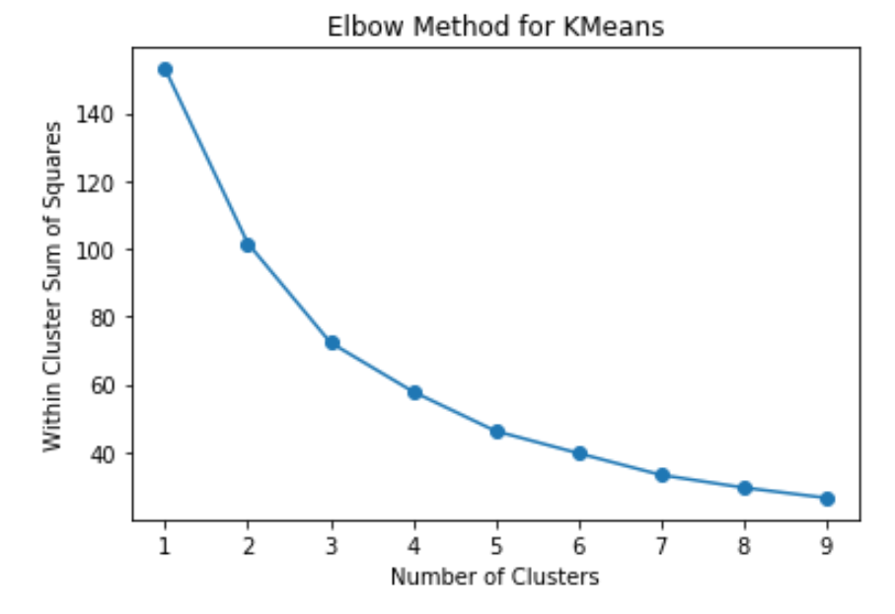
Determining the Ideal number of Clusters
Ideal Number of clusters is at the “elbow”
Of the curve. Hence, ideal number of clusters = 3.

Slide 10
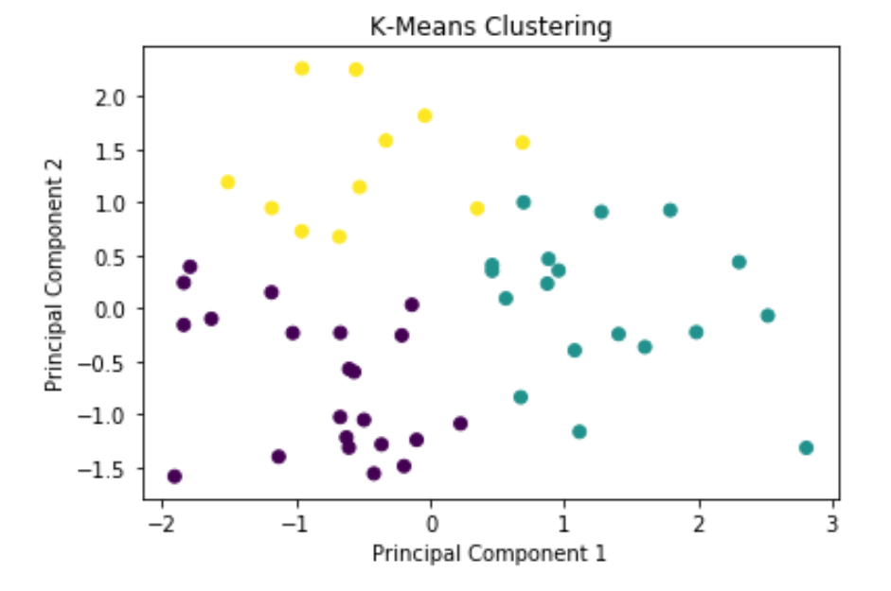
Visualizing Clusters (using Principal Components)

Slide 11
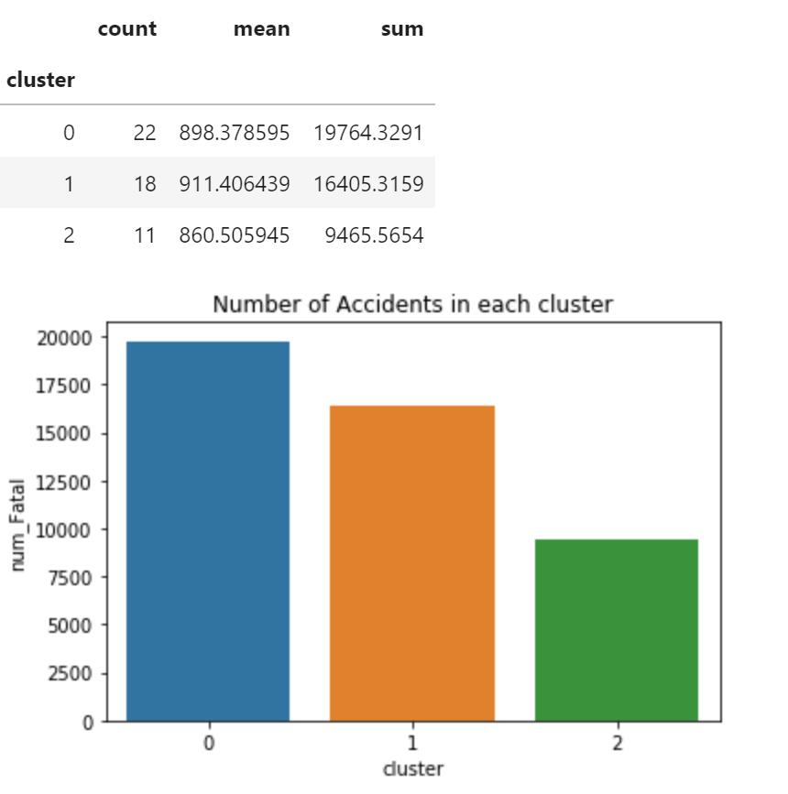
Number of FATAL accidents in each cluster

Slide 12
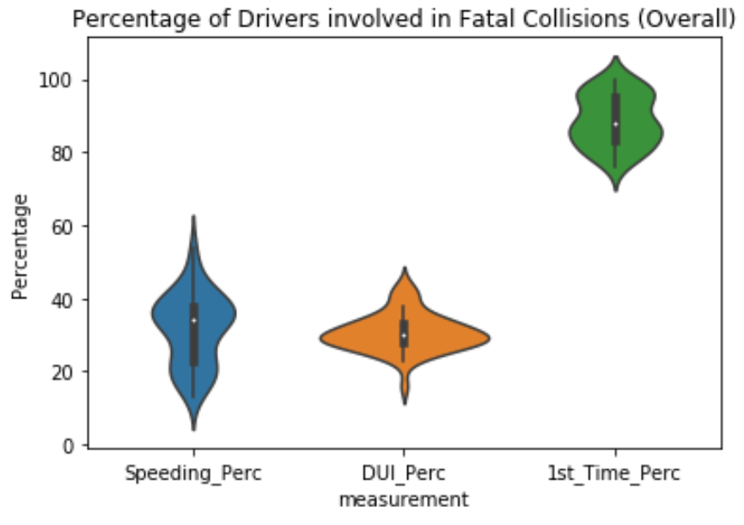
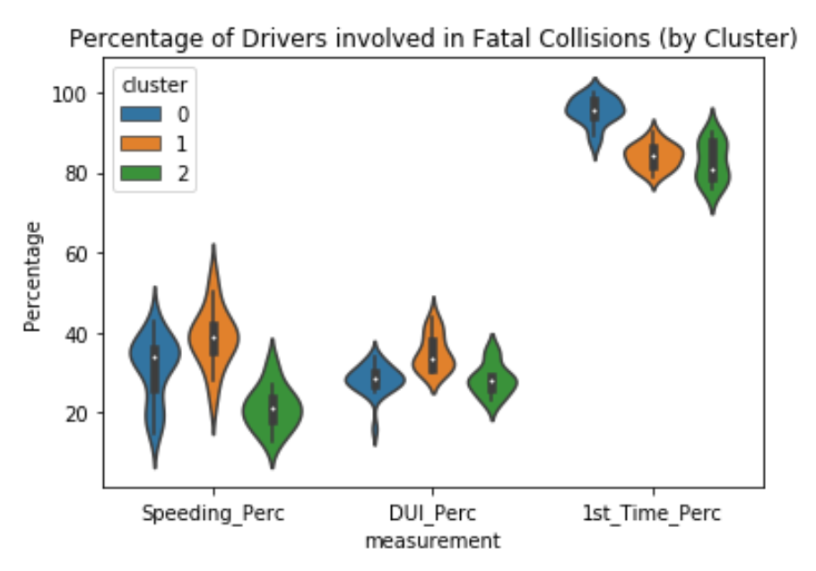
Visualize the feature differences between the clusters

Slide 13
Conclusions
Most of the deaths from road accidents occur with drivers who have never been involved in any kind of road accident before. In other words, “first timers” in accidents are more likely to die.
This number is even higher for states belonging to cluster 1.

Slide 14
Suggestions
Extra measures should be taken to spread awareness about these statistics.
If people who’ve never been in an accident, know that their chances of dying after an accident are SIGNIFICANTLY higher then they might take cautionary measures while driving.
Speed limits and traffic law should be strictly enforced.

